Slide 1
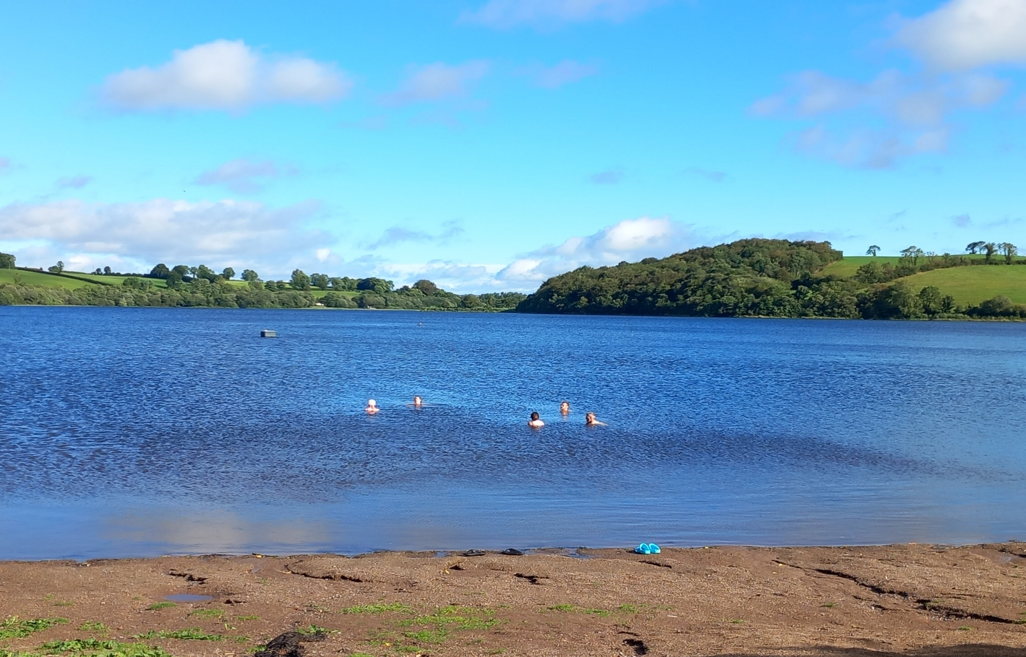

Chapter 1: Water is Essential for All Life
The global impacts of how we use water
Lesson 2 – The Water Cycle

Slide 2


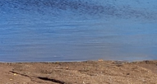
Water is always moving between different physical states of liquid, gas/vapour & solid/frozen for over 4 billion years, i.e.
The Water / Hydrological Cycle
States of water
vapour
solid
liquid
Notes:
Teachers: explain these terms to the students.

Slide 3
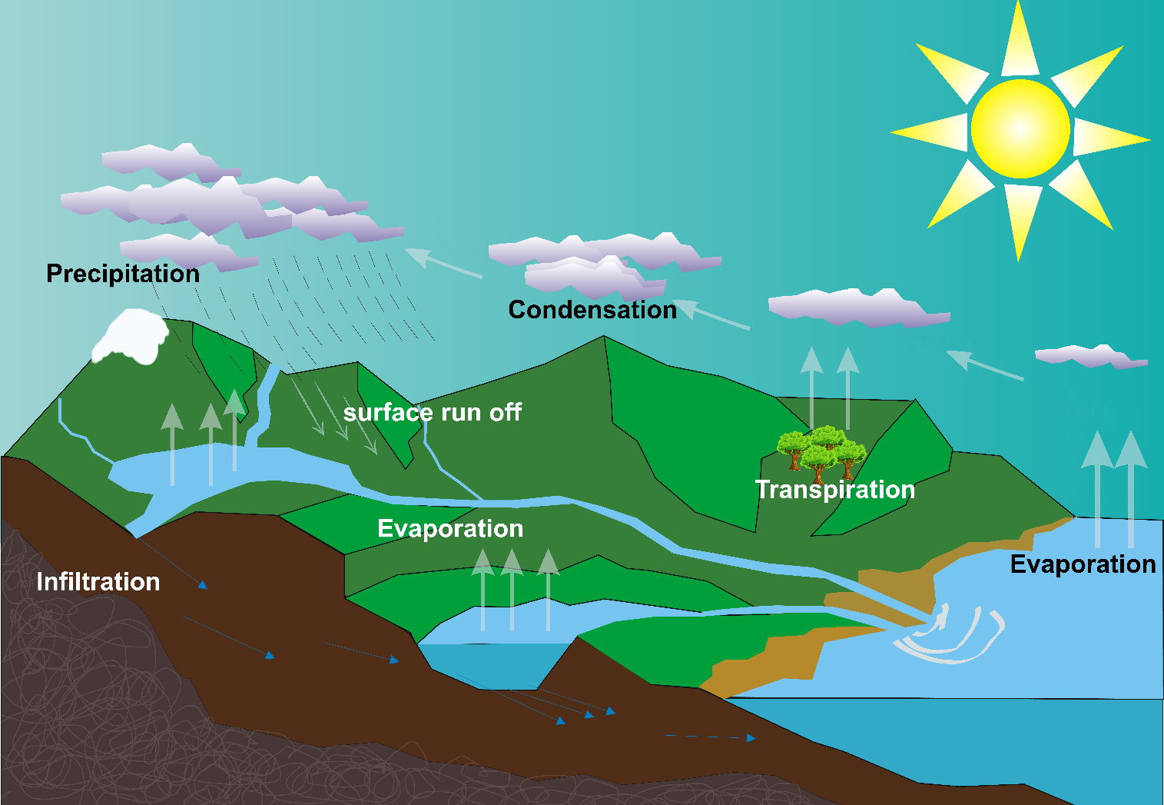
The Water Cycle
Task 2.1
Notes:
Teachers: If we look at a very simplified diagram this is what the water cycle looks like in our environment.
Ask the students is there anything missing from this diagram?
Answer: Humans, towns, schools, hospitals, factories, offices agriculture, animals, etc
Image reference: https://commons.wikimedia.org/wiki/File:Water_cycle_blank.svg

Slide 4




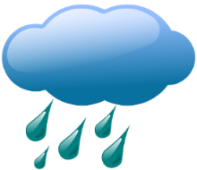


Water is always moving between different physical states
Evaporation: Sun heats up the water in rivers, lakes and land and turns into water vapour in the atmosphere.
Transpiration: When plants absorb water from the soil, the water moves up the stem to the leaf where it then evaporates from the leaf.
Condensation: Water vapour cools as it rises (convection) and collects in clouds, as it condenses it turns into droplets.
Precipitation: When the clouds get big and heavy with water droplets fall to earth as rain, snow or hail.
Collection: Water is stored in a variety of places: oceans, lakes, glaciers, snow caps, rivers and groundwater.
Task 2.2
Notes:
Teachers: explain these terms to the students.

Slide 5
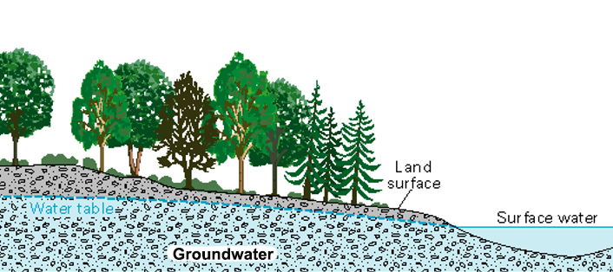
Water is always moving
Overland Flow: After snow melts or rain, the water flows over land and into streams and rivers.
Groundwater: Water that seeps down (percolates) through the soil and collects beneath the earth’s surface.
Source: US Geological Survey
Notes:
Teacher: Water is always moving no matter what its physical state. Vapour and liquid forms move quickly compared to glaciers and snowcaps but they are moving.

Slide 6
What is groundwater?
The water that is filtered through the soil and is available to plants.
It is a major source of drinking water and agriculture irrigation.
Freshwater
Source: US Geological Survey
Notes:
Previously we learned that 30% of freshwater is found in the ground water

Slide 7
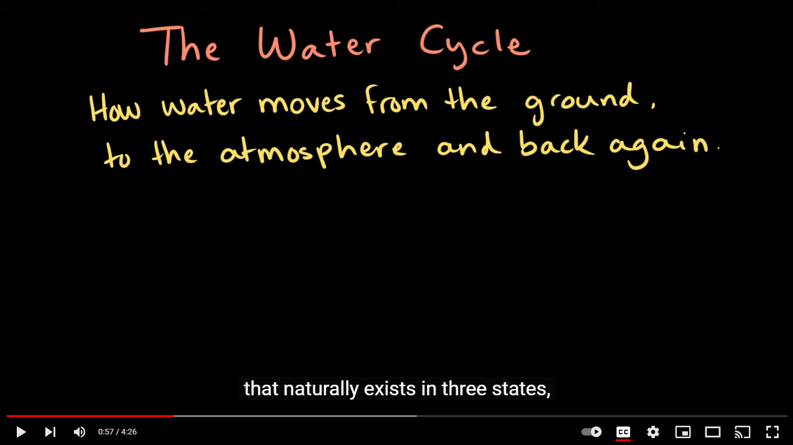

Watch “The Water Cycle” video
The water cycle | Weather and climate | Middle school Earth and space science | Khan Academy – YouTube
Notes:
The water cycle | Weather and climate | Middle school Earth and space science | Khan Academy – YouTube

